Slide 1


Scoring Algorithm for Short Answers & Essays
Team Members
P Karan Jain 1PE12IS065
Sushma N 1PE12IS106
Steffi Crasta 1PE12IS414

Slide 2
Scoring Algorithm for Short Answers & Essays
Problem Statement
To design and implement a system to evaluate Short answers and Essay, and provide a score to them.

Slide 3
Scoring Algorithm for Short Answers & Essays
Literature Survey
Short Answers
Regular expressions are being used to evaluate short answers, but the expressions need to be manually entered for every answer. This tool is used in “Moodle” and is known “RegExp Short Answer question”.
Leacock and Chodorow developed the use of a short-answer scoring system called C-rater, which focuses on semantic information in the text. This is also known as LC Similarity measure technique.
Bachman proposed the use of a short answer assessment system called WebLAS. They extracted regular expressions from a model answer to generate the scoring key.

Slide 4
Scoring Algorithm for Short Answers & Essays
Essays
Mahana, Johns and Apte used Linear Regression model to learn from features such as total word count per essay, sentence count, number of long words, part of speech counts etc.
Lukic and Acuna used a simple naïve Bayes predictor and closed-form solution to linear regression. They extracted several features of the essays, ranging from simple numerical data such as word count and average word length, content speciﬁc numerical data such as misspelled word count and adjective count, and structural data such as average degree and diameter of the essays’ noun-verb relatedness graphs.

Slide 5
Scoring Algorithm for Short Answers & Essays
Citations
[1] Lakshmi Ramachandran, Jian Cheng & Peter Foltz "Identifying Patterns For Short Answer Scoring Using Graph-based Lexico-Semantic Text Matching
[2] Manvi Mahana, Mishel Johns, Ashwin Apte. (2012). Automated Essay Grading using Machine Learning, Stanford University.
[3] Likic, A., & Acuna, V.(n.d.). Automated Essay Scoring, Rice University.

Slide 6
Scoring Algorithm for Short Answers & Essays
Functional Requirements
Accept Short answers and Essays as Input from the user
Evaluation of short answers and Essays by Machine learning algorithms
Obtain Scores as output
Comparison of Human graded Scores and Predicted scores
Visual representation of Scores

Slide 7
Scoring Algorithm for Short Answers & Essays
Non-Functional Requirements
Performance : Grades provided by the system should be consistent with Human graded scores.
Reliability : System should always be able to accept user input and process input.
Scalability : System should be able to store attributes related to essays and short answers.

Slide 8
Scoring Algorithm for Short Answers & Essays
Essay/Short Answer Input
Extract Features
Machine Learning Algorithms
Obtain Scores as output
Visual representation of scores
Architecture

Slide 9



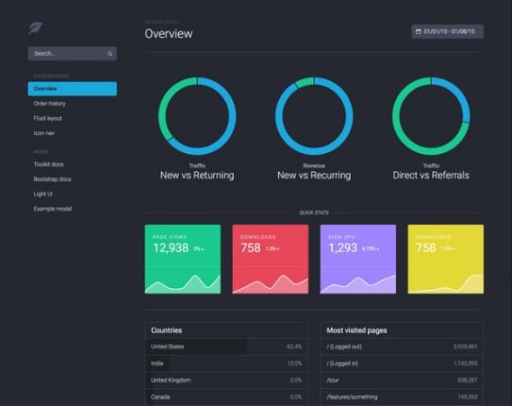

Scoring Algorithm for Short Answers & Essays
Visualization

Slide 10
Scoring Algorithm for Short Answers & Essays
Short Answers Approach
Text Pattern containing content tokens
Text Pattern containing sentence structure information
Extracting content tokens
Semantic Relatedness metric
Extracting Phase Patterns
Other short answers
Top scoring short answers

Slide 11
Scoring Algorithm for Short Answers & Essays
Essay Approach
Training Essays
Feature Extraction
Machine Learning algorithm(Linear regression, N grams, Naïve Bayes)
Test
Error Anaylsis
Visual Representation
Learnt
Parameters
Training
Human Graded Scores
Predicted Scores

Slide 12
Scoring Algorithm for Short Answers & Essays
Development/User environment
Hardware Requirements (Minimum requirements)
  Processor: Intel core i3
  Memory: 256 MB
  Hard disk : 2 GB
Software Requirements
Operating System
  Ubuntu 14.04 (Used for development and testing)
  Any Debian based system for usage.

Slide 13
Scoring Algorithm for Short Answers & Essays
Programming Languages used
  Python 2.7.x or Python 3
  R 3.2.3
Packages used
  Textmining(1.0) package for Python
  Natural Language Toolkit (NLTK) (3.0) package for Python
  Scikit-learn package for Python 2.3 Background modules
Dataset present in flat files.
  Dataset for Short answers provided by The William and Flora Hewlett Foundation (Hewlett Foundation) is sponsoring the Automated Student Assessment Prize (ASAP) hosted on Kaggle.
  Dataset for Essays provided by The William and Flora Hewlett Foundation (Hewlett Foundation) is sponsoring the Automated Student Assessment Prize (ASAP) hosted on Kaggle.
Notes:
TextMining is used for statistical text mining (i.e. the bag-of-words model) and makes it very easy to create a term-document matrix from a collection of documents.
NLTK is used for WordNet, along with a suite of text processing libraries for classification, tokenization, stemming, tagging, parsing, and semantic reasoning, wrappers for industrial-strength NLP libraries
Scikit-Learn is used for classification, regression, dimensionality reduction, clustering and various pre processing tasks

Slide 14
Scoring Algorithm for Short Answers & Essays
Current Status
  We are done with implementing the design architecture.
  Currently working on evaluation of Short Answers, the regular expression technique and graph based techniques.
Notes:
TextMining is used for statistical text mining (i.e. the bag-of-words model) and makes it very easy to create a term-document matrix from a collection of documents.
NLTK is used for WordNet, along with a suite of text processing libraries for classification, tokenization, stemming, tagging, parsing, and semantic reasoning, wrappers for industrial-strength NLP libraries
Scikit-Learn is used for classification, regression, dimensionality reduction, clustering and various pre processing tasks

Slide 15
Scoring Algorithm for Short Answers & Essays
Plan going forward
Deliverables | Deadline | Candidate Responsible
Graph Based Short Answer | 2nd February | Karan
Regular Expression Short Answers | 2nd February | Sushma
LC Based Similarity Short Answers | 9th February | Steffi
Obtain Comparision Results for short answers | 15th February | Sushma
Detailed Literature Survey for Essays | 22nd February | Karan
Implementation of methods for Essays | 1st March | All three

